Slide 1
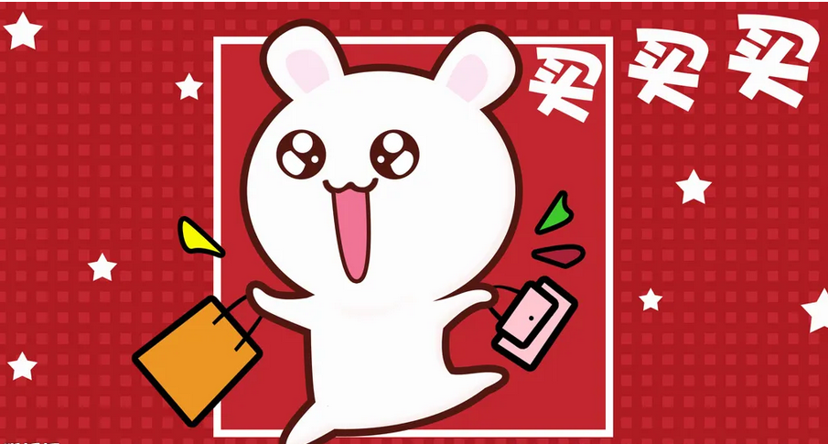


Paragraph 3 吴明鹏
The paradox is that every day we get two sets of messages at odds with each other. One is the “permissive” perspective, “buy, spend, get it now , you need this”
Words and Phrase
Paradox n. 自相矛盾（的情况）
Odds n. （与某物）不一致，相矛盾
Permissive adj. 放纵的 纵容的
Perspective n. （思考的）角度，观点，想法
Upright a. 正直的；诚实的，垂直的；笔直的
Urge vt. 极力劝告；敦促；催促
Appetite n. 欲望；爱好，胃口；食欲
Luxuries n. 奢侈品
Source n. 来源，出处；原因，根源
Family loyalty 家庭的忠诚
The other we could call an “upright” message, which urges us , “work hard and save . Suspended your desires. Avoid luxuries. Control your appetite for more than you truly need.”
This message comes to us from many sources: from school, from parents, even from political figures referring to “traditional values” . Hard work ,family loyalty, and the capacity to postpone Desires are core American values that made our country great.

